Slide 1
IMAGE FORMATION USING PINHOLE CAMERA, PERSPECTIVE PROJECTION, DISTORTION, AND ILLUMINATION EFFECTS
ITA0515 - COMPUTER VISION
Guided By:
Dr. Carmel Mary Belinda M
Presented By: Harshavardhan R V (192472163)
Y. Jayesh Ranjan (192472201)
M. Someswar Reddy (192472081)
P. Paneendra(192321072)

Slide 2
INTRODUCTION
Image formation converts a real-world scene into a digital image.
Cameras capture light reflected from objects to create images.
The pinhole camera model explains the basic image formation process.
Perspective projection maps 3D objects onto a 2D image plane.
Lens distortion can alter the shape and accuracy of images.
Illumination effects influence image brightness, contrast, and quality.

Slide 3
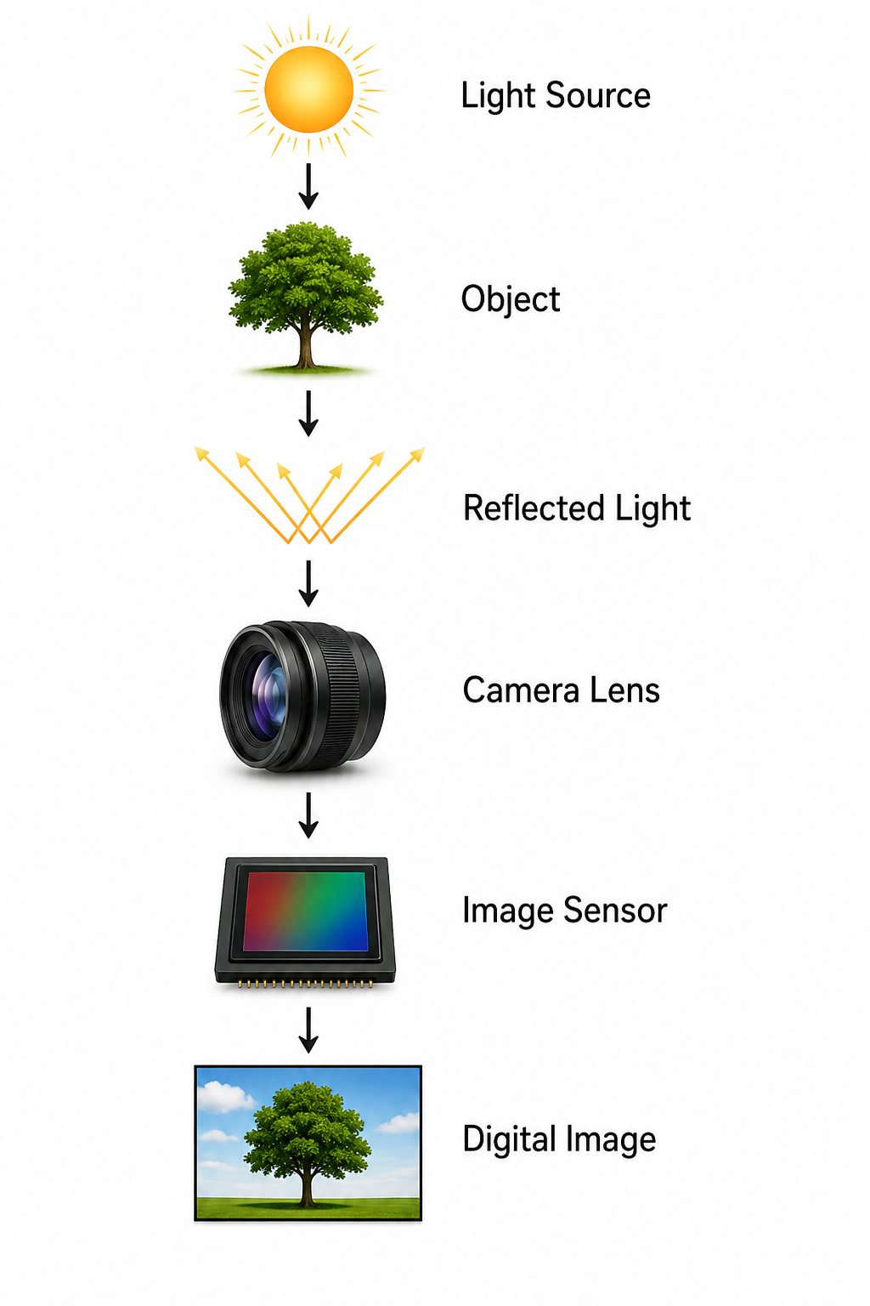
IMAGE FORMATION PROCESS
Light source illuminates the object.
Object reflects the light rays.
Camera lens collects and focuses the light.
Image sensor converts light into electrical signals.
Signals are processed into a digital image.

Slide 4
PINHOLE CAMERA MODEL
Uses a tiny pinhole instead of a lens.
Light rays pass through a single opening.
Forms an inverted image on the image plane.
Produces sharp images with accurate geometry.
Eliminates lens distortion because no lens is used.
Serves as the basic model for understanding image formation in computer vision.

Slide 5
PERSPECTIVE PROJECTION
Projects three-dimensional objects onto a two-dimensional image plane accurately.
Objects farther from the camera appear noticeably smaller than nearby objects.
Preserves depth information for realistic representation of real-world scenes.
Simulates human vision by maintaining natural object size relationships.
Widely used in computer vision, robotics, and three-dimensional graphics.
Enables accurate scene analysis, object detection, and distance estimation.

Slide 6
DISTORTION AND ILLUMINATION EFFECTS
Image Distortion
Barrel distortion
Pincushion distortion
Tangential distortion
2. Illumination Effects
Low lighting
Overexposure
Shadows
Reflections
Uneven brightness
3. Impact
Reduces image quality.
Affects object detection.
Lowers recognition accuracy.

Slide 7
APPLICATIONS
Face recognition identifies individuals using captured facial images accurately.
Autonomous vehicles detect roads, obstacles, and traffic conditions safely.
Medical imaging supports accurate diagnosis high-quality digital images.
Robotics enables navigation, object detection, and automated task execution.
Surveillance systems improve security continuous real-time image monitoring.
Augmented reality combines digital objects with real-world camera views.

Slide 8
CONCLUSION
Image formation converts real-world scenes meaningful digital images accurately.
Pinhole camera model explains the fundamental principles of image formation.
Perspective projection creates realistic images with accurate depth perception.
Distortion and illumination significantly influence overall image quality accuracy.
Understanding image formation improves performance of modern computer.
These concepts support advancements in robotics, healthcare, autonomous systems.

Slide 9

